Slide 1
Does dockless bike-sharing create a competition for losers?
Hongyu Zheng
Assistant Professor of Industrial & Systems Engineering
A joint work with Kenan Zhang, Marco Nie. Presented at ITEA 2025

Slide 2
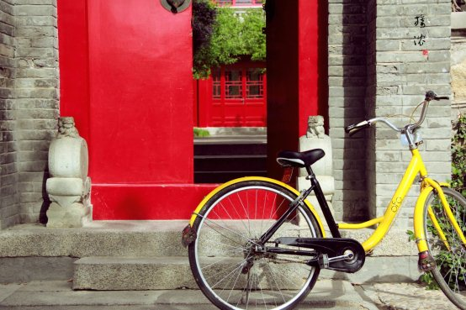
Dockless bike-sharing (DLB)
Easily reach smartphone users
Minimal infrastructure cost
No regulations
Ofo was born on the campus of Beijing University, China, 2015.
Notes:
To answer this question, let‘s first briefly review the history of DLB service. The first large-schale DLB operator was born in China in 2015. It quickly gain popularity as it easily reached smartphone users who can look for idle bikes in real-time.
Compared to docked bikesharing, the DLB bikes could be found and parked anywhere.
For DLB operators, it has minimal infrastructure cost, and at the time there was no regulations at all. Therefore, you can imagine this is a market with a very low entry cost.

Slide 3
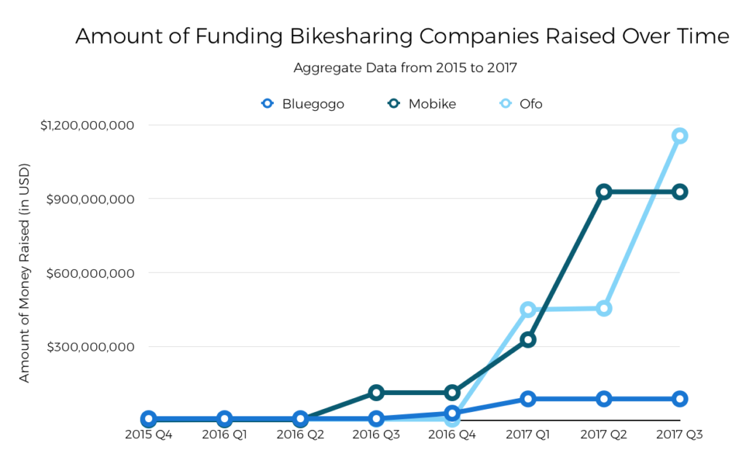
The rise of dockless bike-sharing (DLB)
Fleet size increased 10,000-fold in three years, to 23 million by 2018.
Ridership reached 70 million per day at the peak.
Source: Crunchbase News
Notes:
This leads to a rapid rise of the DLB market. As you can see in this figure, the amount of funding grew exponentially and the ------.

Slide 4
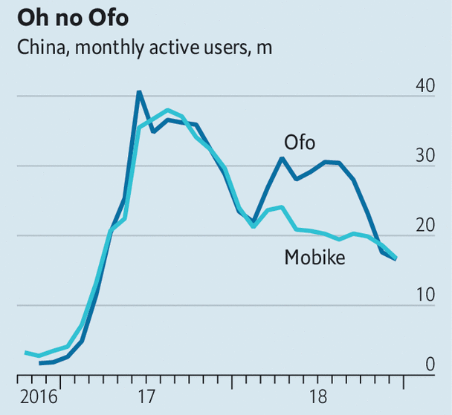
The quick fall
DLB became the victim of its own success.
Low entry cost
Fierce competition
Excessive supply and price wars
Intrusion to the public space; struggle to maintain and rebalance fleets
Source: The Economist
Notes:
However, in just two years after that, the market quickly cooled, the number of active users began to drop. Eventually, most startups failed, including Ofo, which is literally the icon of the industry.
So, what happened? In some way, DLB is the victim of its own success. The low entry cost and fierce competition led to excessive supply and nasty price wars.
Bikes were left everywhere in public spaces. And the operators began to struggle with maintaining and rebalancing their fleets.

Slide 5
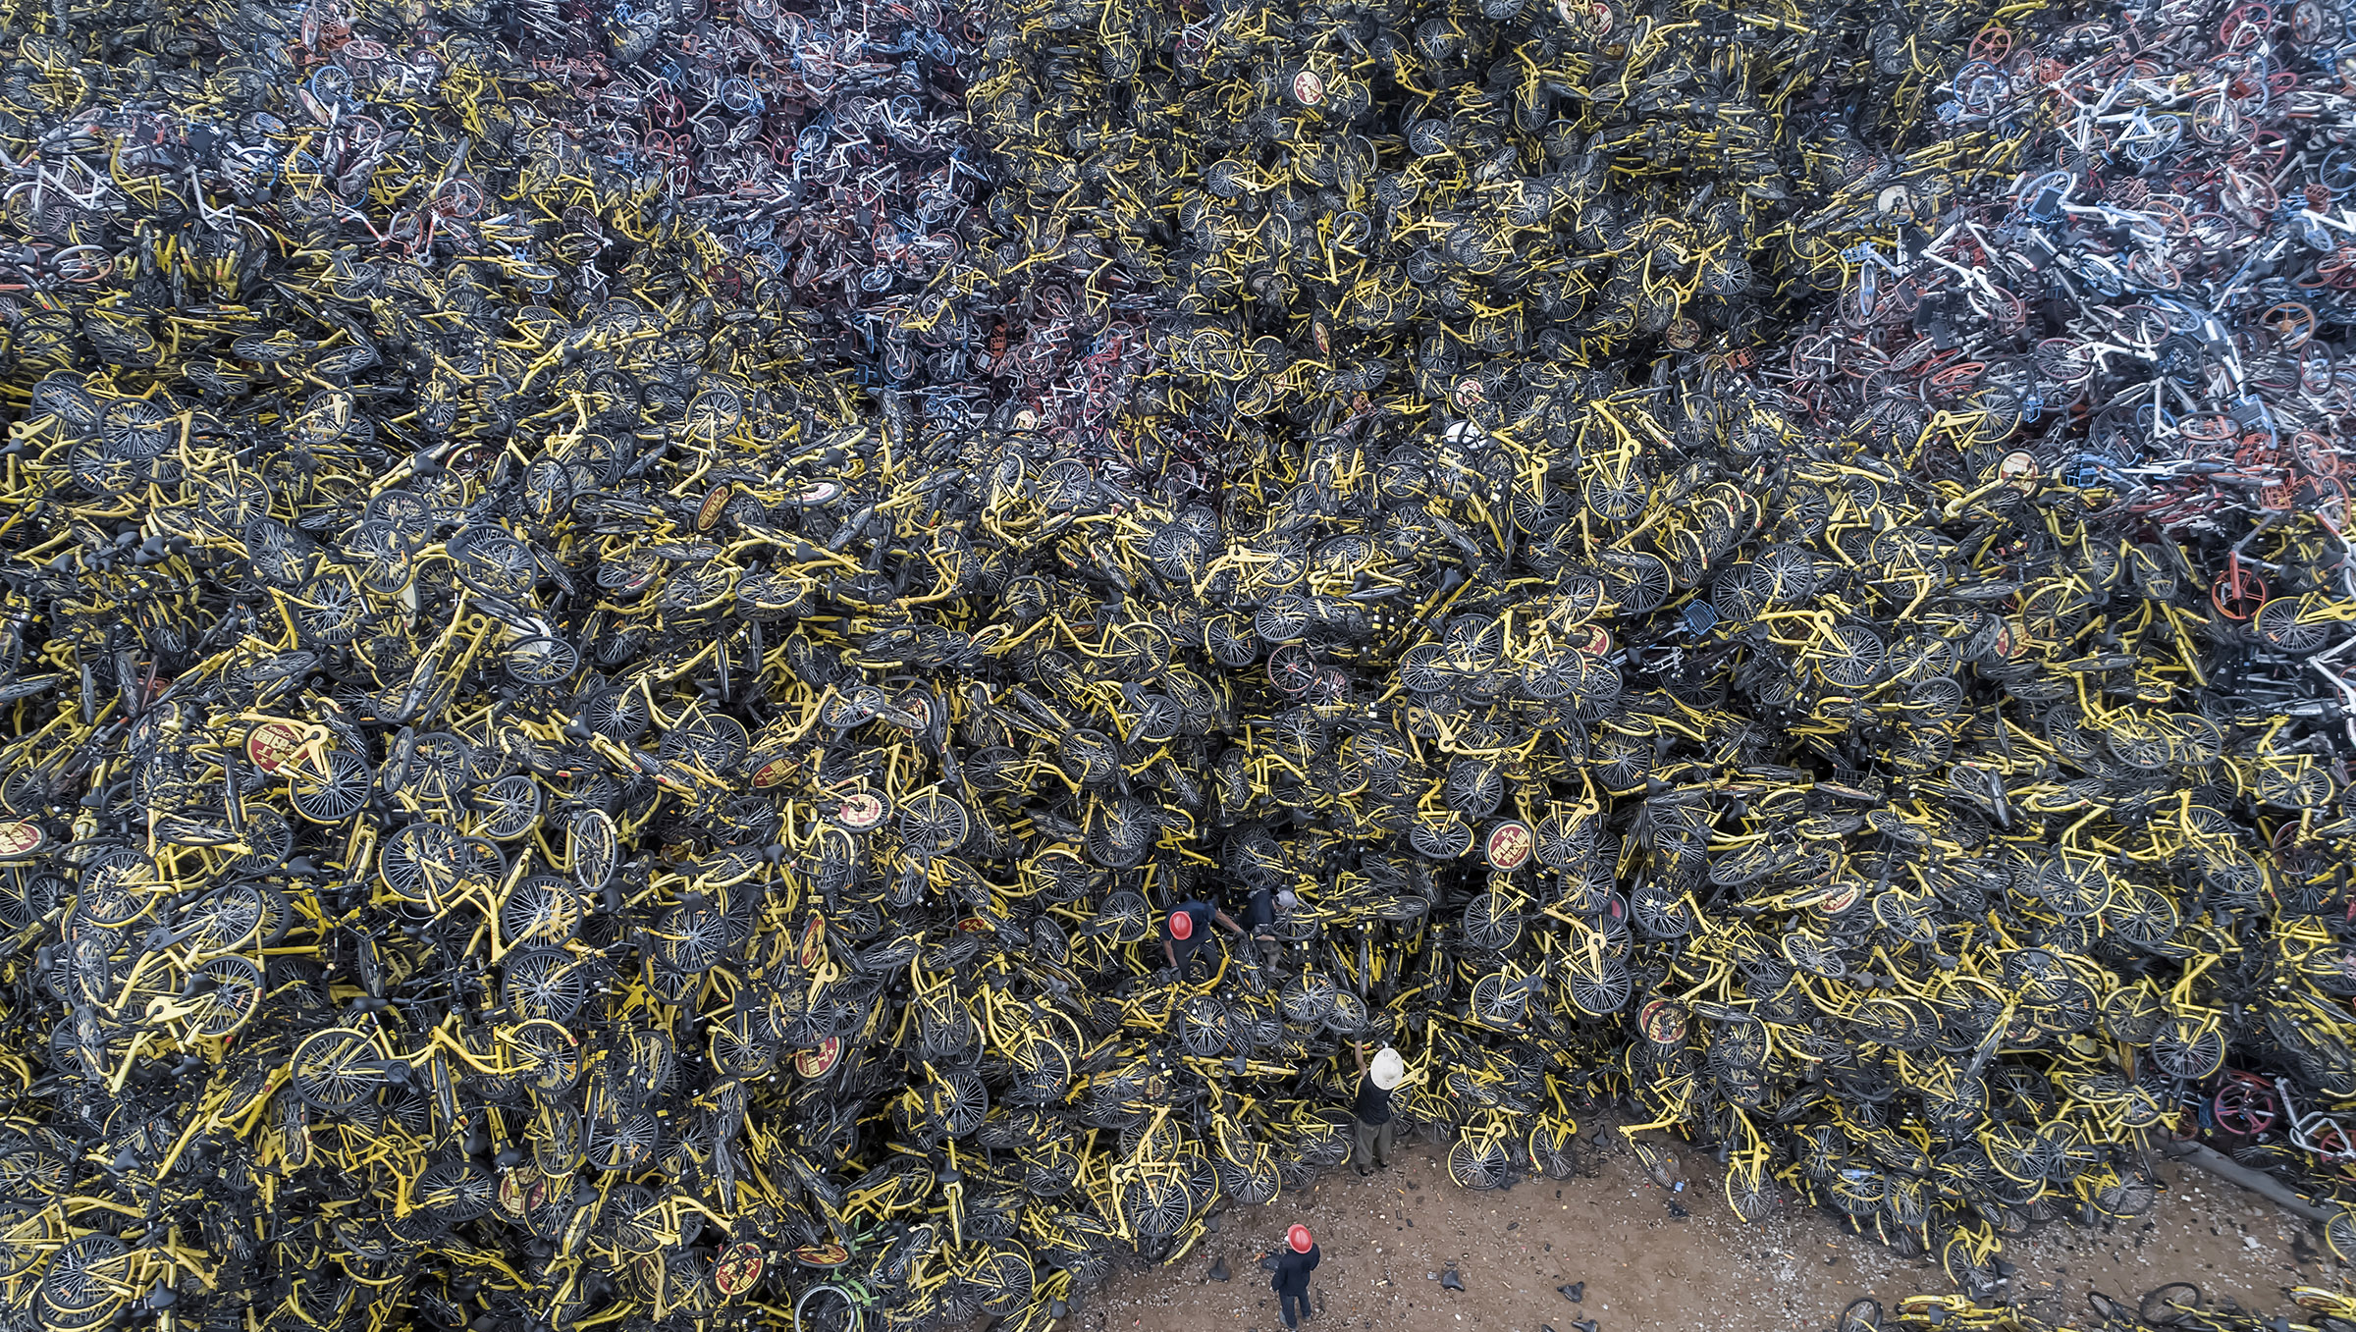
Abandoned shared bikes are piled up like a hill in Xiamen, China. Source: No Place to Place (phmuseum.com)
Notes:
And this is the result of the market failure.
Abandoned shared bikes were piled up like mountains in many cities of China.
You can see the size of the workers compared to the bikes. This is not only a waste but a new problem for the city to solve.

Slide 6
Research question
An educated guess of the proper size and price of DLB service?
For operators planning to enter the market
For a planner seeking to maximize social welfare
Why is the market oversupplied and how to avoid it?
Research approach
Develop a parsimonious model of DLB market that endogenizes travelers’ mode choice and key bike operations.
Propose a dynamic game to analyze inter-operator competition.
Notes:
So, in this presentation, the research question I want to answer is that can we make an educated guess of the proper size and price of the DLB service in a city for operators planning to enter the market, or for A planner seeking to maximize social welfare?
Also, I want to know why the market is oversupplied in real life and how to avoid it.
My approach to these questions is to -----.

Slide 7
An overview of the model
Demand
Travelers choose travel mode based on cost
Average performance of the market across time
Supply
Focus on fleet size and fare rate
Assumption:
Travelers' origin and destination are uniformly distributed in space
Supply:
each operator’s decisions
DLB demand for
all operators
Fare rate
Marker share/bike usage/rebalancing
Access time
#idle bikes
Fleet size
Operator-wise variables are highlighted in color
Notes:
First, let’s start with an overview of the model. On the demand side, ------, ------. In this work, we want to focus on the average -----. Therefore, we are not going to consider a specific spatial or temporal demand profile. We just assume ------.
Now we have the total demand, it will further be distributed to each operator and this will determine their bike usage and how many bikes need to be rebalanced. Combined with the fleet size, this will determine the number of idle bikes in the system, which will further influence travel's access time to the service.
On the supply side, --- Lastly, just to highlight, the variables in color are those of each operator, instead of the whole market.
--------------------------------------------------------------------------------Uniform distribution assumption, of course, is strong, and unlikely to hold in reality. In the case of bikesharing, I think it is overly optimistic, and may lead to overestimate the market share and underestimate the rebalancing cost. However, to simplify the analysis, this seems an assumption that we must make.

Slide 8
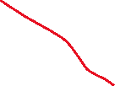

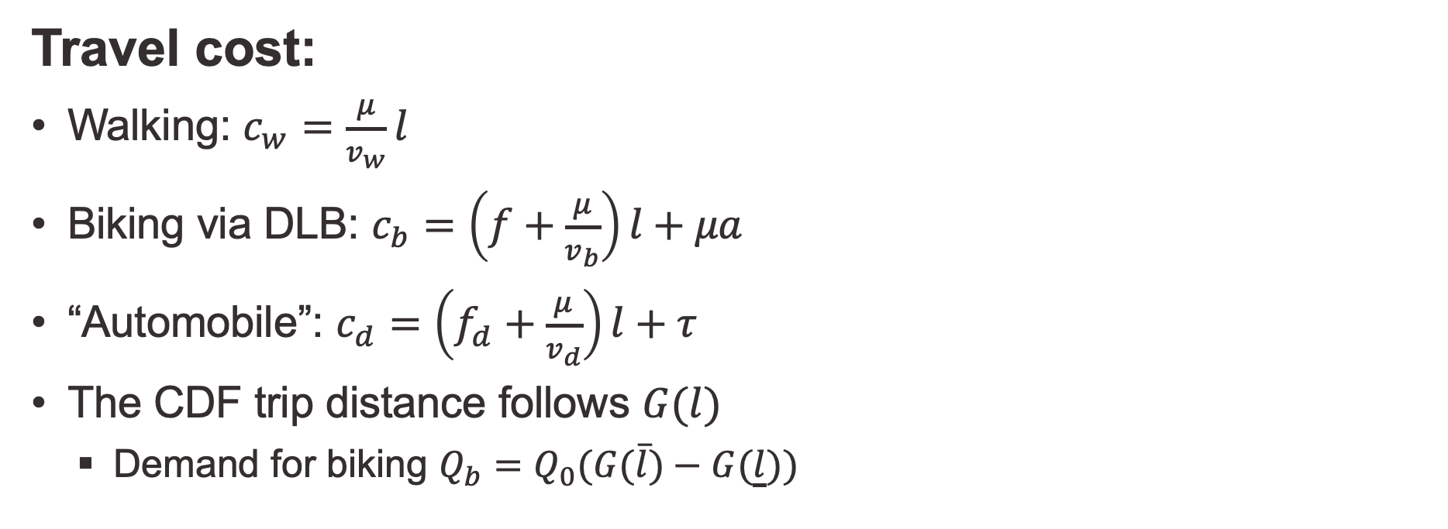
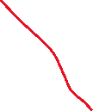
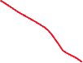
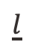
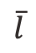
Demand: mode choice
High fixed cost, low variable cost
No fixed cost, high variable cost
Value of time
Medium fixed cost, medium variable cost
Travel cost:
Walking: $c_{w}=\frac{μ}{v_{w}}l$
Biking via DLB: $c_{b}=\left(f+\frac{μ}{v_{b}}\right)l+μa$
“Automobile”: $c_{d}=\left(f_{d}+\frac{μ}{v_{d}}\right)l+τ$
The CDF trip distance follows $G(l)$
Demand for biking $Q_{b}=Q_{0}(G(\overline{l})−G(\underline{l}))$
DLB fare rate
Access time
$$\underline{l}$$
$$\overline{l}$$
$$l$$
Illustration of mode split in a simplified mobility market
Notes:
Now let’s get into some details.
Travelers must choose from three modes: walking, biking via DLB, and a composite motorized mode that includes taxi, public transit and private vehicle.
Mode choice plays the role of demand function, it determines how the DLB demand varies the price and access time. The logic is straight-forward, -------.
------------------------------------------------------------------------------
This matches our intuition. Walking is preferred for shorter trips and driving is best with longer trips. And biking is between the two.

Slide 9
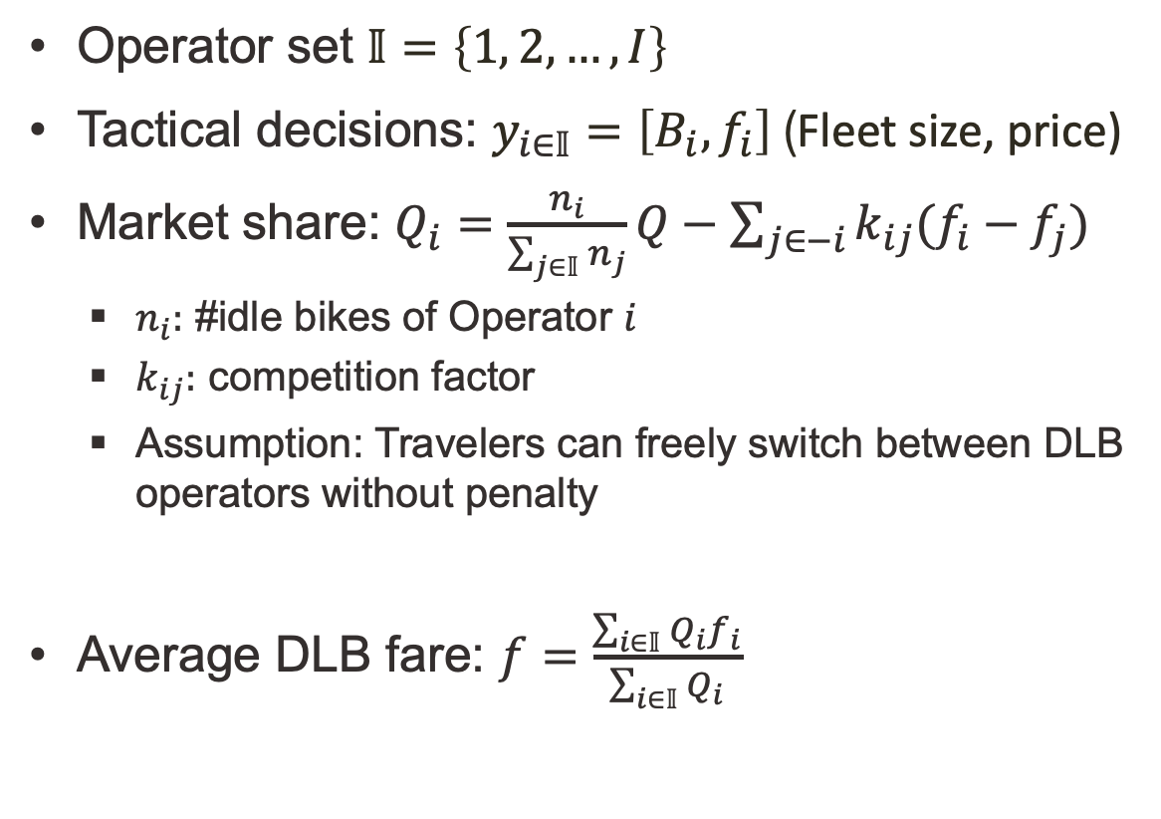
Demand: each operators’ market share
Operator set $𝕀=\left\{1, 2, …,I\right\}$
Tactical decisions: $y_{i∈𝕀}=\left[B_{i},f_{i}\right]$ (Fleet size, price)
Market share: $Q_{i}=\frac{n_{i}}{\sum_{j∈𝕀}{n_{j}}}Q−\sum_{j∈−i}{k_{ij}(f_{i}−f_{j})}$
$n_{i}:$ #idle bikes of Operator $i$
$k_{ij}:$ competition factor
Assumption: Travelers can freely switch between DLB operators without penalty
Average DLB fare: $f=\frac{\sum_{i∈𝕀}{Q_{i}f_{i}}}{\sum_{i∈𝕀}{Q_{i}}}$
Notes:
Given multiple operators ------, their decisions not only jointly determine the total DLB demand, but also their individual share of that demand.
Specifically, each operator’s market share depends on its share of idle bikes in the market, as well as the difference between its fare and the competitors‘ fare. This equation depends on the assumption that ----, which matches our observation that most DLB users in China don’t need to pay a membership and have access to all operators’ services.
Lastly, the average DLB fare is weighted by market share of each operator
---------------------------------------------------------------
Here, the competition factor is assumed constant. This linear setting is widely used to analyze pricing competition and can guarantee demand conservation.

Slide 10
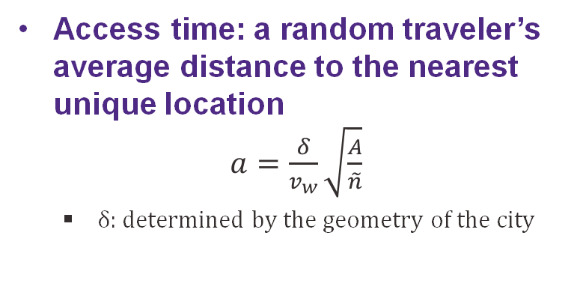
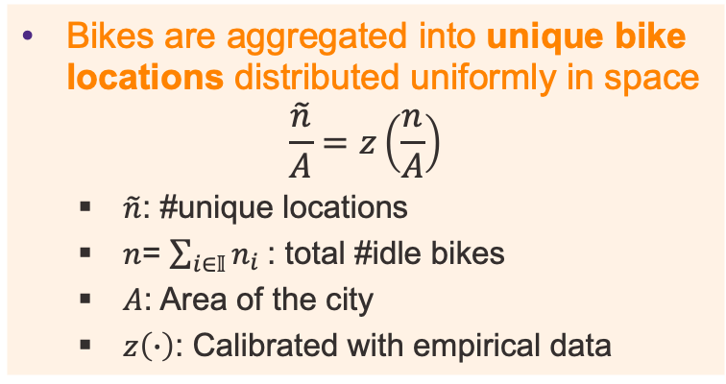
Supply: access time
Bikes are aggregated into unique bike locations distributed uniformly in space
$$\frac{\tilde{n}}{A}=z\left(\frac{n}{A}\right)$$
$\tilde{n}$: #unique locations
$n$= $\sum_{i∈𝕀}{n_{i}}$: total #idle bikes
$A$: Area of the city
$z\left(∙\right)$: Calibrated with empirical data
Access time: a random traveler’s average distance to the nearest unique location
$a=\frac{δ}{v_{w}}\sqrt{\frac{A}{\tilde{n}}}$
$δ$: determined by the geometry of the city
Notes:
On the supply side, we found that, in the real world, idle bikes are usually aggerated into clusters (like the circles in this figure). So we define them as unique bike locations, and assume they are uniformly distributed in space.
And the relationship between idle bike density and unique location density can be captured using a function calibrated from data.
We can estimate the access time from -----. This formula is well-known in the literature and has been widely used in taxi studies.

Slide 11
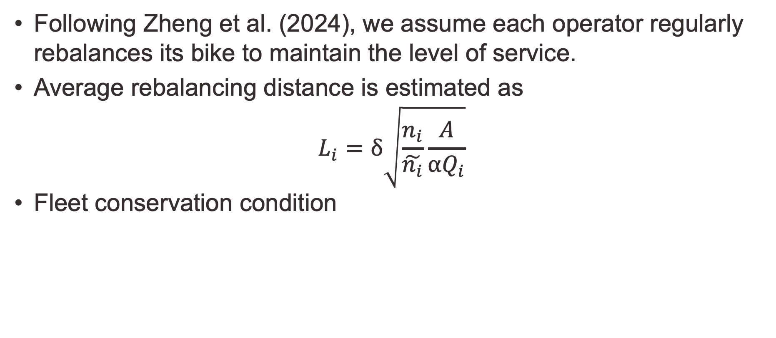
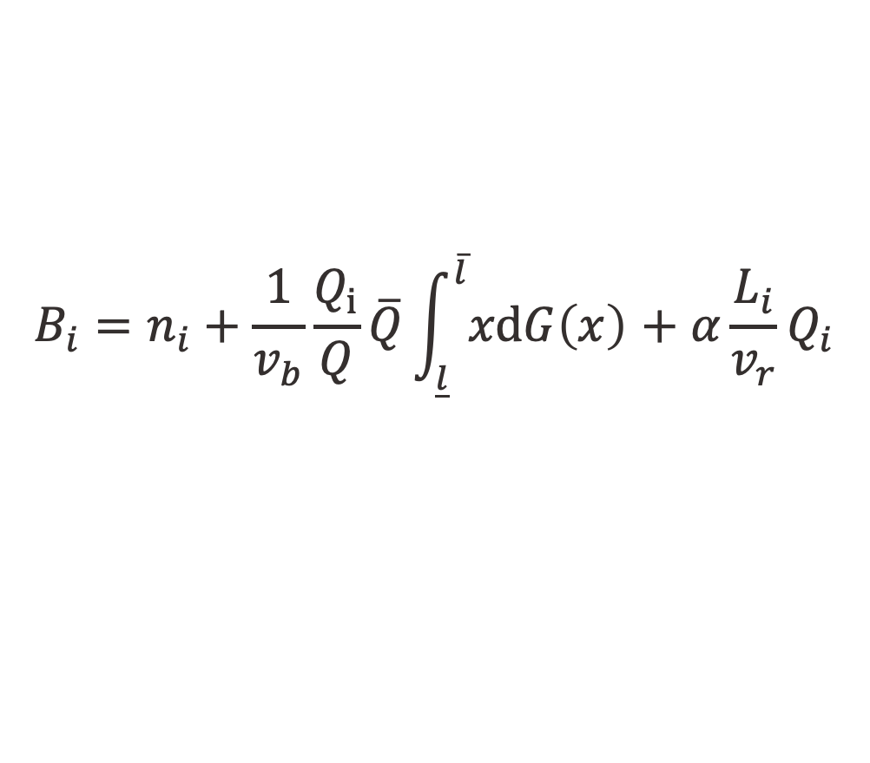
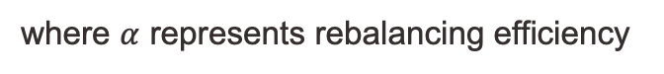
Supply: rebalancing
Following Zheng et al. (2024), we assume each operator regularly rebalances its bike to maintain the level of service.
Average rebalancing distance is estimated as
$$L_{i}=δ\sqrt{\frac{n_{i}}{\tilde{n_{i}}}\frac{A}{αQ_{i}}}$$
Fleet conservation condition
where $α$ represents rebalancing efficiency
Total parking time of idle bikes
Total trip duration of occupied bikes
Rebalancing time
$$B_{i}=n_{i}+\frac{1}{v_{b}}\frac{Q_{i}}{Q}\overline{Q}\int_{\underline{l}}^{\overline{l}}{xdG\left(x\right) }+α\frac{L_{i}}{v_{r}}Q_{i}$$
Reference: Zheng, Zhang, Nie, Yan, and Qu, (2024) How many are too many? analyzing dockless bike-sharing systems with a parsimonious model. Transportation Science, 58(1), pp.152-175.
Notes:
Lastly, bike rebalancing is modeled following our previous study, where -----.
While many studies focus on the logistics of rebalancing, in our study, we simplify this operational level detail in order to focus on high-level decisions.
***
Under such setting, the total bike time is composed of parking time, occupied time and rebalancing time.

Slide 12
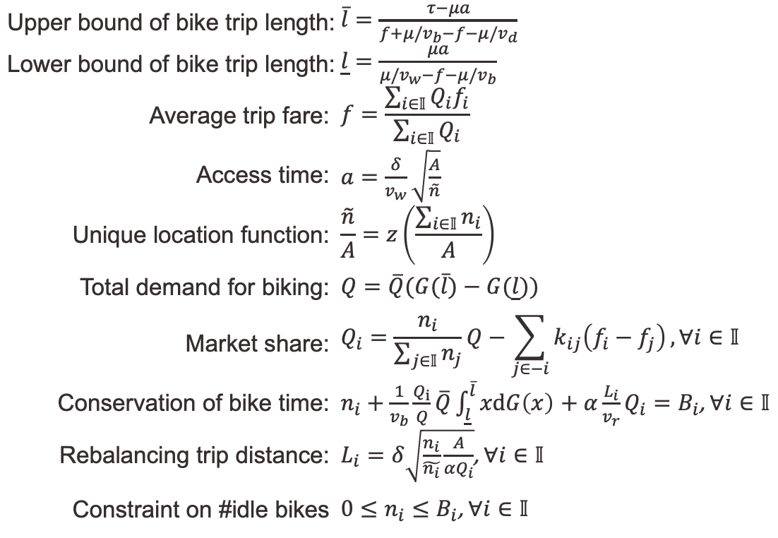
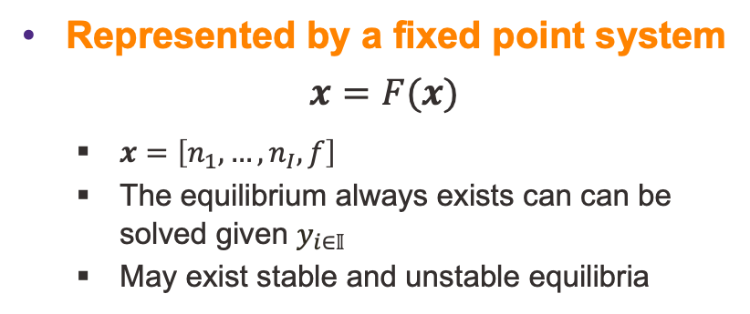
Market equilibrium
Represented by a fixed point system
$$x=F(x)$$
$x=\left[n_{1}, …,n_{I},f\right]$
The equilibrium always exists can can be solved given $y_{i∈𝕀}$
May exist stable and unstable equilibria
Upper bound of bike trip length: | $\overline{l}=\frac{τ−μa}{f+μ/v_{b}−f−μ/v_{d}}$
Lower bound of bike trip length: | $\underline{l}=\frac{μa}{μ/v_{w}−f−μ/v_{b}}$
Average trip fare: | $$f=\frac{\sum_{i∈𝕀}{Q_{i}f_{i}}}{\sum_{i∈𝕀}{Q_{i}}}$$
Access time: | $a=\frac{δ}{v_{w}}\sqrt{\frac{A}{\tilde{n}}}$
Unique location function: | $$\frac{\tilde{n}}{A}=z\left(\frac{\sum_{i∈𝕀}{n_{i}}}{A}\right)$$
Total demand for biking: | $Q=\overline{Q}(G(\overline{l})−G(\underline{l}))$
Market share: | $$Q_{i}=\frac{n_{i}}{\sum_{j∈𝕀}{n_{j}}}Q−\sum_{j∈−i}{k_{ij}\left(f_{i}−f_{j}\right)},∀i∈𝕀$$
Conservation of bike time: | $n_{i}+\frac{1}{v_{b}}\frac{Q_{i}}{Q}\overline{Q}\int_{\underline{l}}^{\overline{l}}{xdG\left(x\right) }+α\frac{L_{i}}{v_{r}}Q_{i}=B_{i}$, $∀i∈𝕀$
Rebalancing trip distance: | $L_{i}=δ\sqrt{\frac{n_{i}}{\tilde{n_{i}}}\frac{A}{αQ_{i}}}$, $∀i∈𝕀$
Constraint on #idle bikes | $0≤n_{i}≤B_{i}$, $∀i∈𝕀$
Proposition 1:
An operator can always gain market share by putting more bikes on streets.
Proposition 2:
Existence of “free-ride”
When one operator decreases price, its competitor’s ridership may increase.
Effect of attracting more travelers using DLB > Effect of higher market proportion
Notes:
Now we are ready to formulate the market equilibrium conditions, most of these equations have already been shown before.
We can ----
---------------------------------------------------------------
I would like to pause here and to see if there is any questions about the model or any clarification needed.
Excellent, I’ve got a great audience here.

Slide 13
How do operators make decisions?
What is the business goal?
How to achieve it?
Dynamic game
All players move simultaneously at each level with full information
Strategic Level
Tactical Level
Notes:
Till now, we have formulated the market dynamics given all operators‘ decisions. Now, let us think about how their decisions are made.
There are two critical decisions here. First, they need to determine a business goal. Then they need to figure out how to achieve it. The first question is a decision at the strategic level, while the second one is at the tactical level.
This is the intuition of our dynamic game structure.
--------------------------------
repeated game
sequential game: one player chooses their action before the others choose theirs
stage game: Repeated game with reputation
Markov game: stochastic game

Slide 14
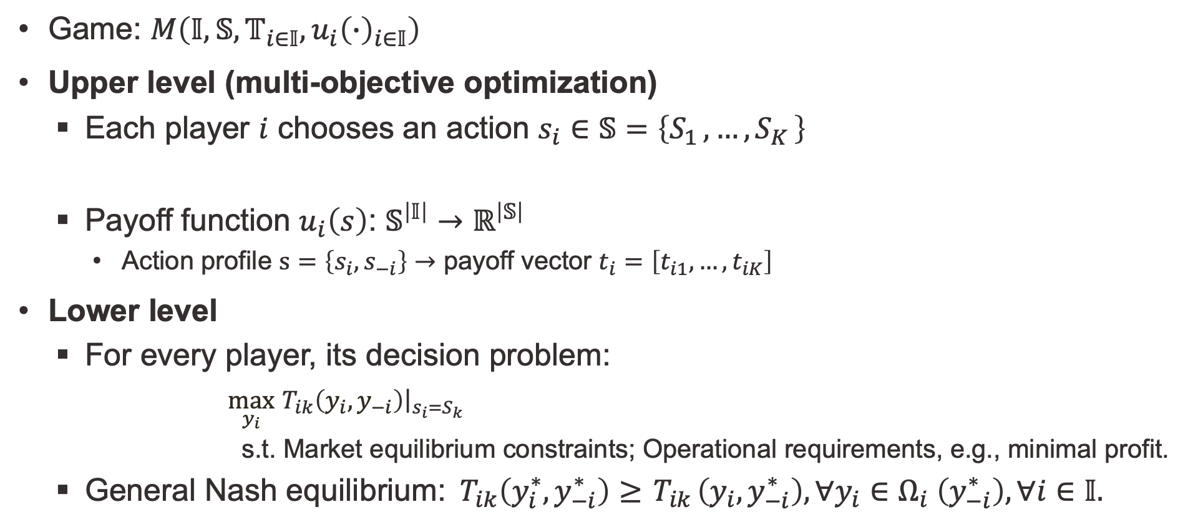
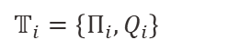
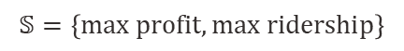
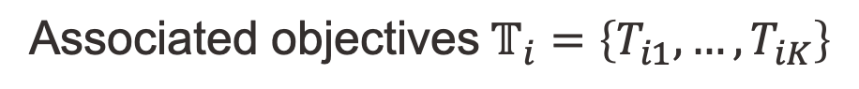
Dynamic game
Game: $M\left(𝕀,𝕊,𝕋_{i∈𝕀},u_{i}{\left(∙\right)}_{i∈𝕀}\right)$
Upper level (multi-objective optimization)
Each player $i$ chooses an action $s_{i}∈𝕊=\left\{S_{1 }, …,S_{K }\right\}$
Payoff function $u_{i}\left(s\right)$: $𝕊^{\left|𝕀\right|}→ℝ^{\left|𝕊\right|}$
Action profile $s=\left\{s_{i},s_{−i}\right\}$ $→$ payoff vector $t_{i}=\left[t_{i1}, …,t_{iK}\right]$
Lower level
For every player, its decision problem:
$\max_{y_{i}} { T}_{ik}\left(y_{i},y_{−i}\right){\left.​\right|}_{s_{i}=S_{k}}$
$\text{s}\text{.}\text{t}\text{.}$Market equilibrium constraints; Operational requirements, e.g., minimal profit.
General Nash equilibrium:${ T}_{ik}\left(y_{i}^{∗},y_{−i}^{∗}\right)≥{ T}_{ik}\left(y_{i},y_{−i}^{∗}\right),∀y_{i}∈Ω_{i} \left(y_{−i}^{∗}\right), ∀i∈𝕀.$
Example:
$$𝕊=\left\{max profit,max ridership\right\}$$
$$\text{Associated} \text{objectives} 𝕋_{i}=\left\{T_{i1}, …,T_{iK}\right\}$$
$$𝕋_{i}=\left\{Π_{i},Q_{i}\right\}$$
solved using a Bi-level Dual Gradient Descent (BDGD) algorithm based on automatic differentiation
Tactical decisions
Notes:
Now, let me introduce the general form of the dynamic game. At the upper ------.
-----, with the action profile that includes of all operators' actions
At the lower level, every player will choose tactical decisions to achieve the goal of objectives at the upper level, with -----constraints.
Why hard to solve:
This produces a GNE with equilibrium constraints that captures market dynamics.
I propose a tailored algorithm to solve it within minutes.
Update all operator decision simultaneously instead of iteratively updating each one.

Slide 15
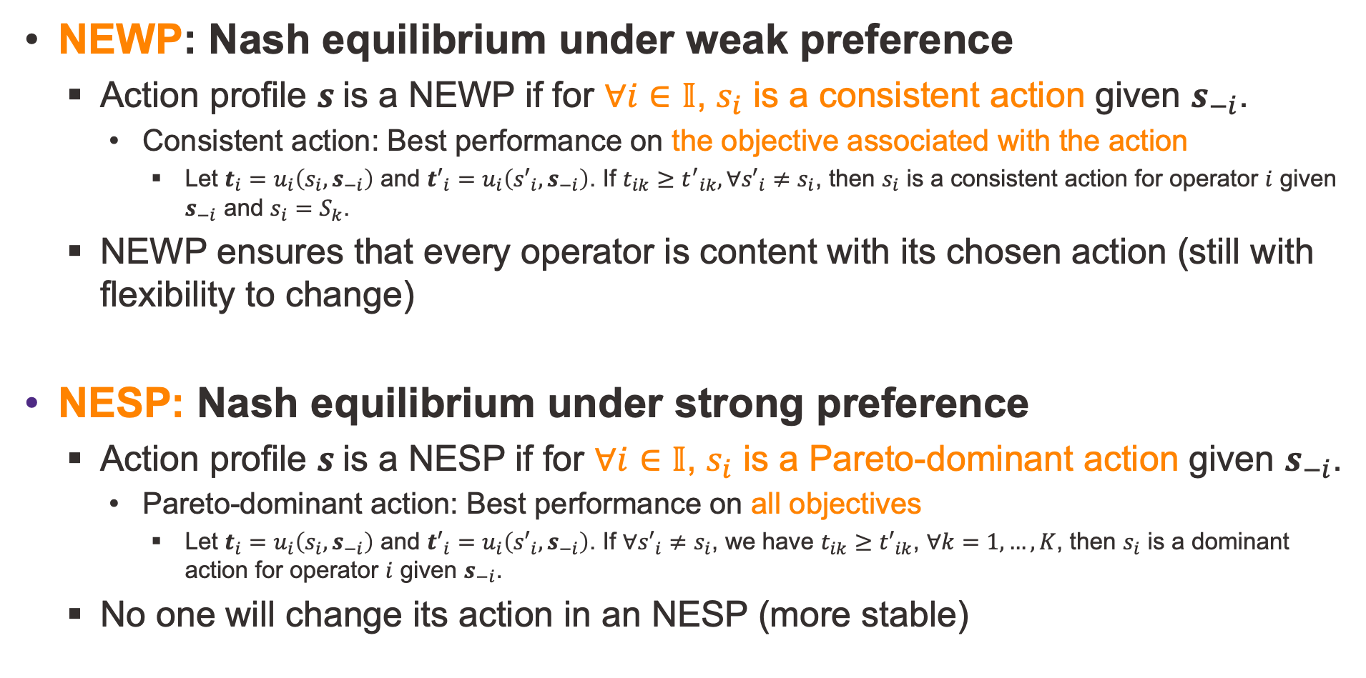
NEWP: Nash equilibrium under weak preference
Action profile $s$is a NEWP if for $∀i∈𝕀$, $s_{i}$ is a consistent action given $s_{−i}$.
Consistent action: Best performance on the $\text{objective}$ associated with the action
Let $t_{i}=u_{i}\left(s_{i},s_{−i}\right)$ and ${t′}_{i}=u_{i}\left({s′}_{i},s_{−i}\right)$. If $t_{ik}≥{t^{′}}_{ik},∀{s′}_{i}≠s_{i}$, then $s_{i}$ is a consistent action for operator $i$ given $s_{−i}$ and $s_{i}=S_{k}$.
NEWP ensures that every operator is content with its chosen action (still with flexibility to change)
NESP: Nash equilibrium under strong preference
Action profile $s$is a NESP if for $∀i∈𝕀$, $s_{i}$ is a Pareto-dominant action given $s_{−i}$.
Pareto-dominant action: Best performance on all $\text{objectiv}$es
Let $t_{i}=u_{i}\left(s_{i},s_{−i}\right)$ and ${t′}_{i}=u_{i}\left({s′}_{i},s_{−i}\right)$. If $∀{s′}_{i}≠s_{i}$, we have $t_{ik}≥{t′}_{ik}$, $∀k=1,…,K$, then $s_{i}$ is a dominant action for operator $i$ given $s_{−i}$.
No one will change its action in an NESP (more stable)
Notes:
So that was the structure of the dynamic game.
Now, to analyze the possible results of the game, we need to define two nash equilibria.
We SAY an action profile -----, for any ------, which means it has the best performance ------ compared to other actions.
The most important thing to remember here is that NEWP is a possible flexible case, while NESP is more stable and more likely to happen if exists.
------------------------------------------
Please note that the existence and uniqueness of both nash equilibria depend on the payoff vectors emerged from the lower-level game, which itself is built on complicated market dynamics.

Slide 16
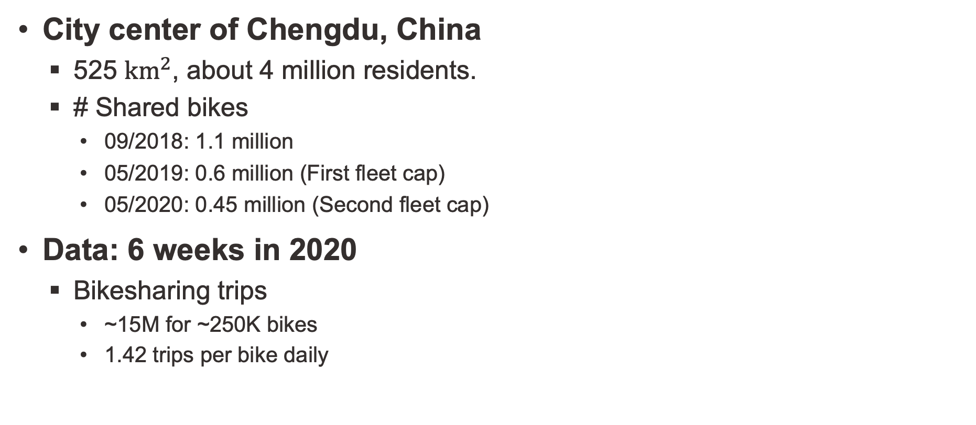
Case study
City center of Chengdu, China
525 ${km}^{2}$, about 4 million residents.
# Shared bikes
09/2018: 1.1 million
05/2019: 0.6 million (First fleet cap)
05/2020: 0.45 million (Second fleet cap)
Data: 6 weeks in 2020
Bikesharing trips
~15M for ~250K bikes
1.42 trips per bike daily
Notes:
To see how our model performs in the real world, we consider a case study based on the ------.
At its peak,

Slide 17
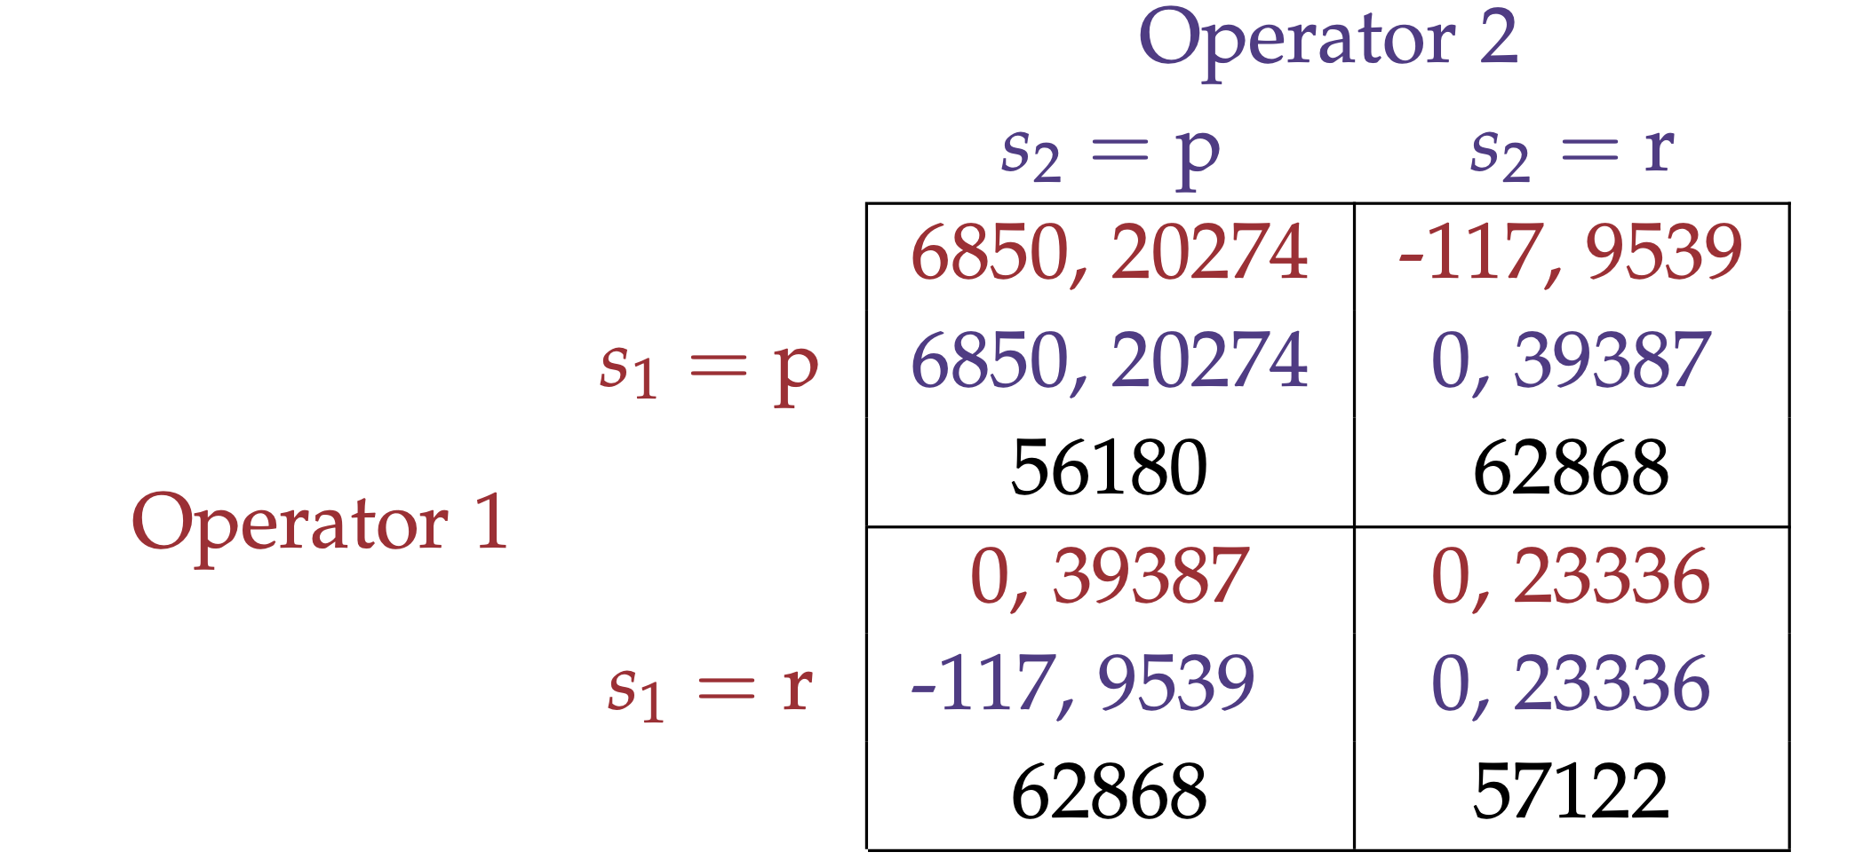
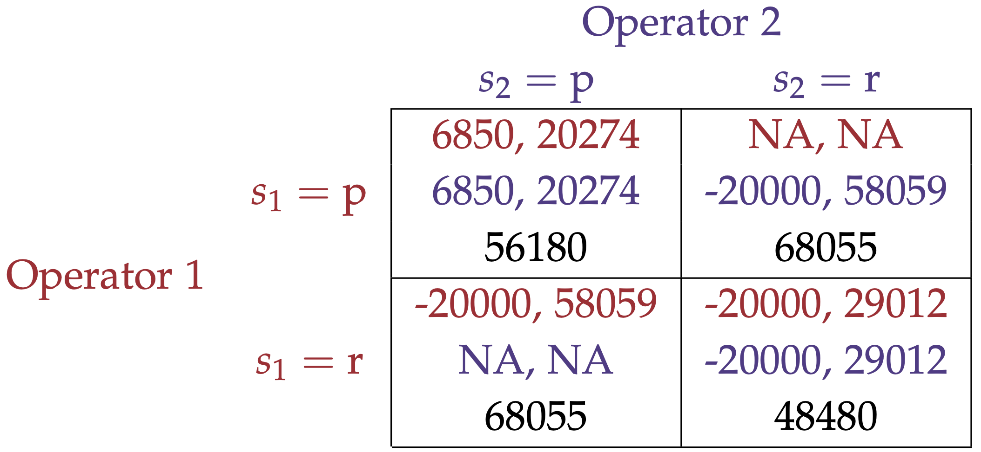
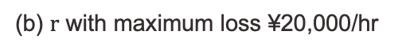
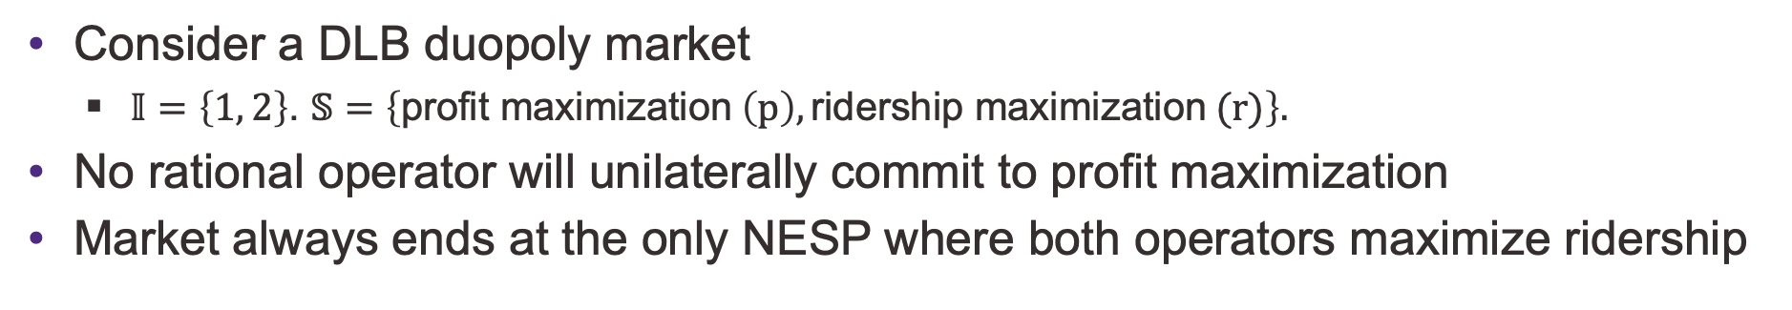
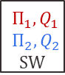
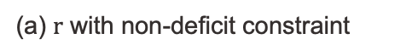
Market failure under inter-operator competition
Consider a DLB duopoly market
$𝕀=\left\{1, 2\right\}$. $𝕊=\left\{\text{profit} \text{maximization} \left(p\right),\text{ridership} \text{maximization} (r)\right\}.$
No rational operator will unilaterally commit to profit maximization
Market always ends at the only NESP where both operators maximize ridership
Without deficit
max loss ¥20,000/hr
NEWP
NEWP
How to read the system performances in each cell:
$$Π_{1},Q_{1}$$
$$Π_{2}, Q_{2}$$
$$SW$$
Operator 1
Operator 2
NESP Low social welfare
NESP Low social welfare
(a) $r$ with non-deficit constraint
(b) $r$ with maximum loss ¥20,000/hr
Profit
Social
welfare
Ridership
Notes:
Once the model is calibrated, we consider a DLB duopoly market and the operator could either maximize profit or ridership.
Here are some results. Note that the action of ridership maximization here has a non-deficit constraint. And each cell in the table corresponds to a specific target profile. For example ------.
First thing you may notice is ------. Suppose -----, it will be worse off in both objectives when the competitor choose to maximize ridership. If Operator 1 chooses to maximize ridership, then Operator 2 has one dominant action, which is maximizing ridership as well. So, you can see that -------. Unfortunately, this is not a favorable result between it has a low social welfare.
If we relax the budget constraint to allow a loss of twenty thousand per hour, the result is very similar.
So can we avoid this?

Slide 18
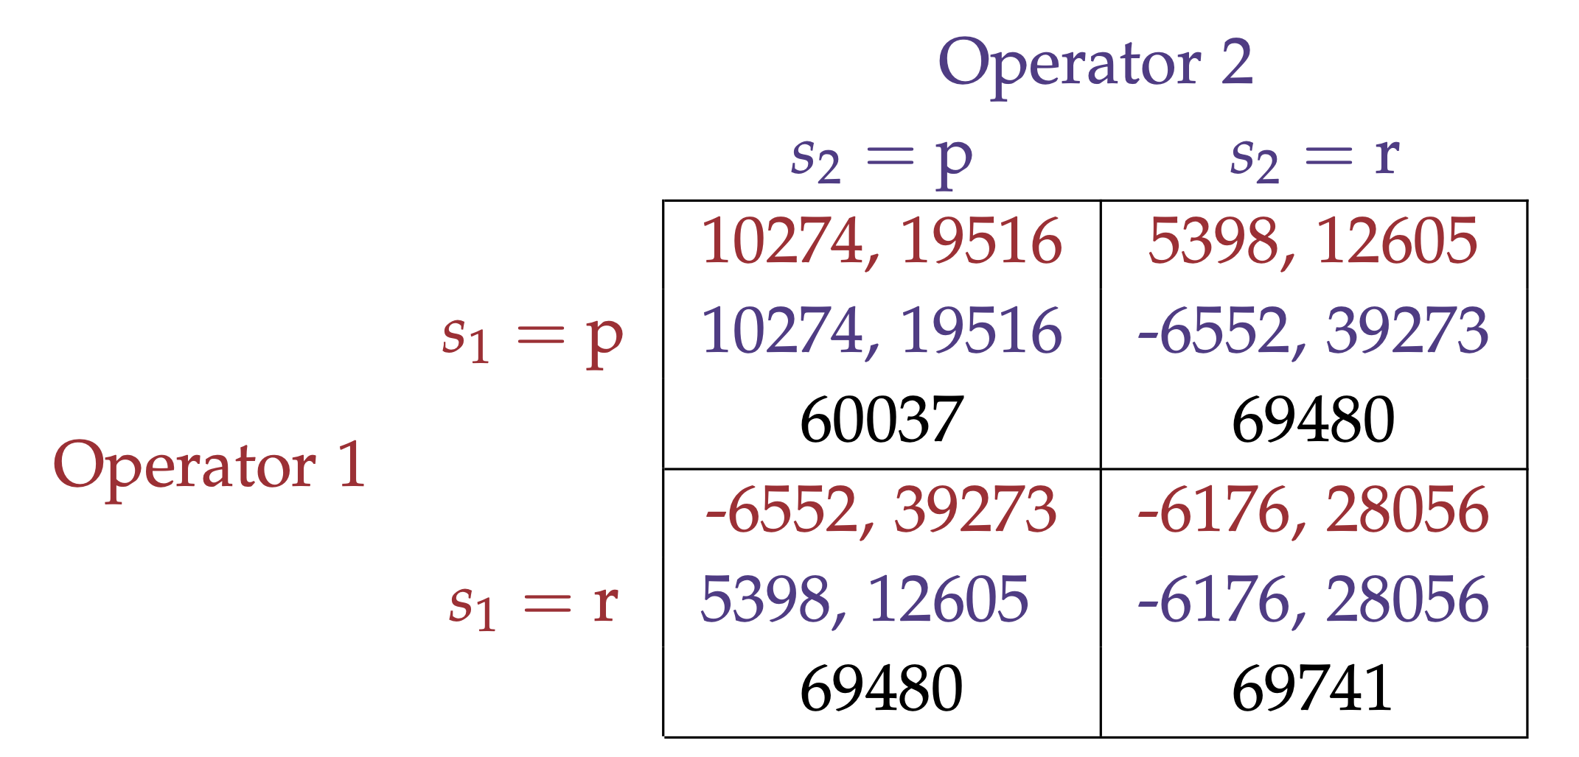
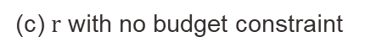
Role of regulation
Fleet cap (~60k) on each operator
All action profiles are NEWP
Operators have complete freedom to choose their actions
Avoid market failure, improve social welfare and profitability
Maximizing profit
Maximizing ridership with no budget constraint
How to read the system performances in each cell:
All action profiles are NEWP
$$Π_{1},Q_{1}$$
$$Π_{2}, Q_{2}$$
$$SW$$
Operator 1
Operator 2
(c) $r$ with no budget constraint
Profit
Social
welfare
Ridership
Notes:
Well, a simple regulation can help. I have experimented with a lot of regulations. Here I just give you what I found is the most effective -----------

Slide 19
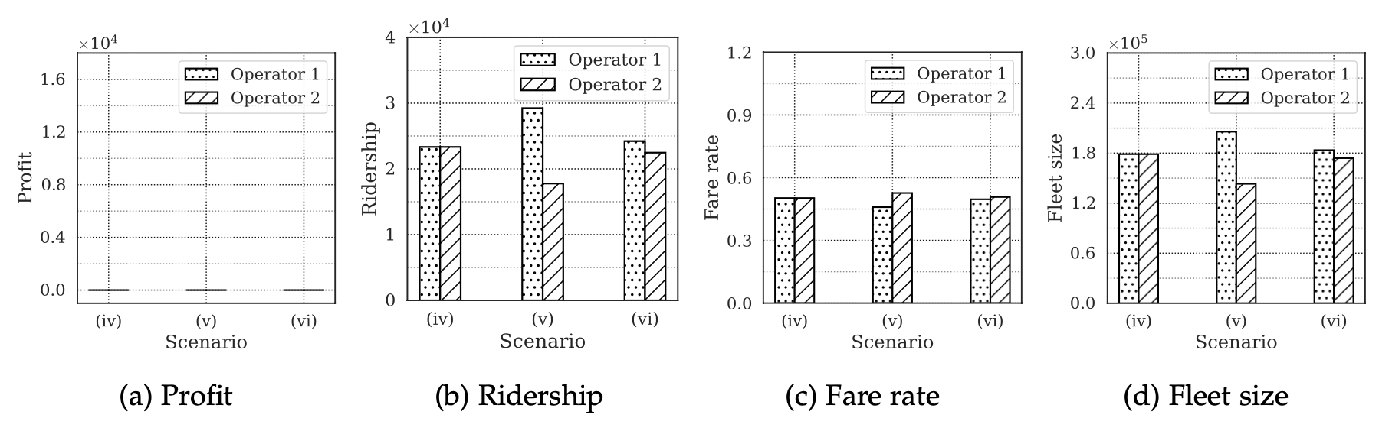
High market volatility
Asymmetric duopoly (both operator maximize ridership)
(i) - Operator 1 and 2 have the same parameters;
(ii) - Operator 1 has one percent lower acquisition cost;
(iii) - Operator 1 has one percent better rebalancing efficiency.
A slight improvement can swing the outcome wildly.
(i) (ii) (iii) (i) (ii) (iii) (i) (ii) (iii) (i) (ii) (iii)
System performances for ridership-maximizing operators with non-deficit constraint
Notes:
Beyond that result, I also found that the market has a high volatility.
In the highlighted area. Even if one operator has one percent lower acquisition cost, ----

Slide 20
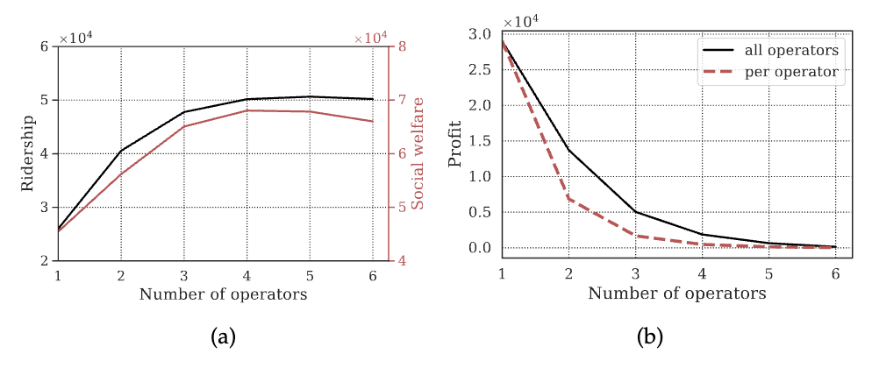
Low profitability
Profit plunges with #operators if focusing on making money
At social optimal, each operator’s profit is less than 2% of that in a monopoly
Profit drops quickly with #operators
Social optimal
System performances in an oligopoly market with different #operators.
Notes:
Lastly, I also found that the inter-operator competition leads to low profitability of the market.

Slide 21
Summary
Propose a dynamic game structure and define the Nash equilibrium under weak/strong preference
Explain the instability of an unregulated DLB market
If one operator wants to dominate the market, the others have to do the same.
High volatility and low profitability
Regulation policies:
Fleet cap, if implemented properly, can avoid the market failure.
Zheng, Zhang, and Nie. (2025) Does dockless bike-sharing create a competition for losers? (under revision in Transportation Science)
Notes:
A few takeaways from this presentation.
------ This dilemma creates a race to the bottom, in which everyone is basically competing to lose more money.

Slide 22
Thank you! Find me at https://zhenghongyu.github.io/ Email: zheng@utk.edu Phone: (865) 974-3591

Slide 23
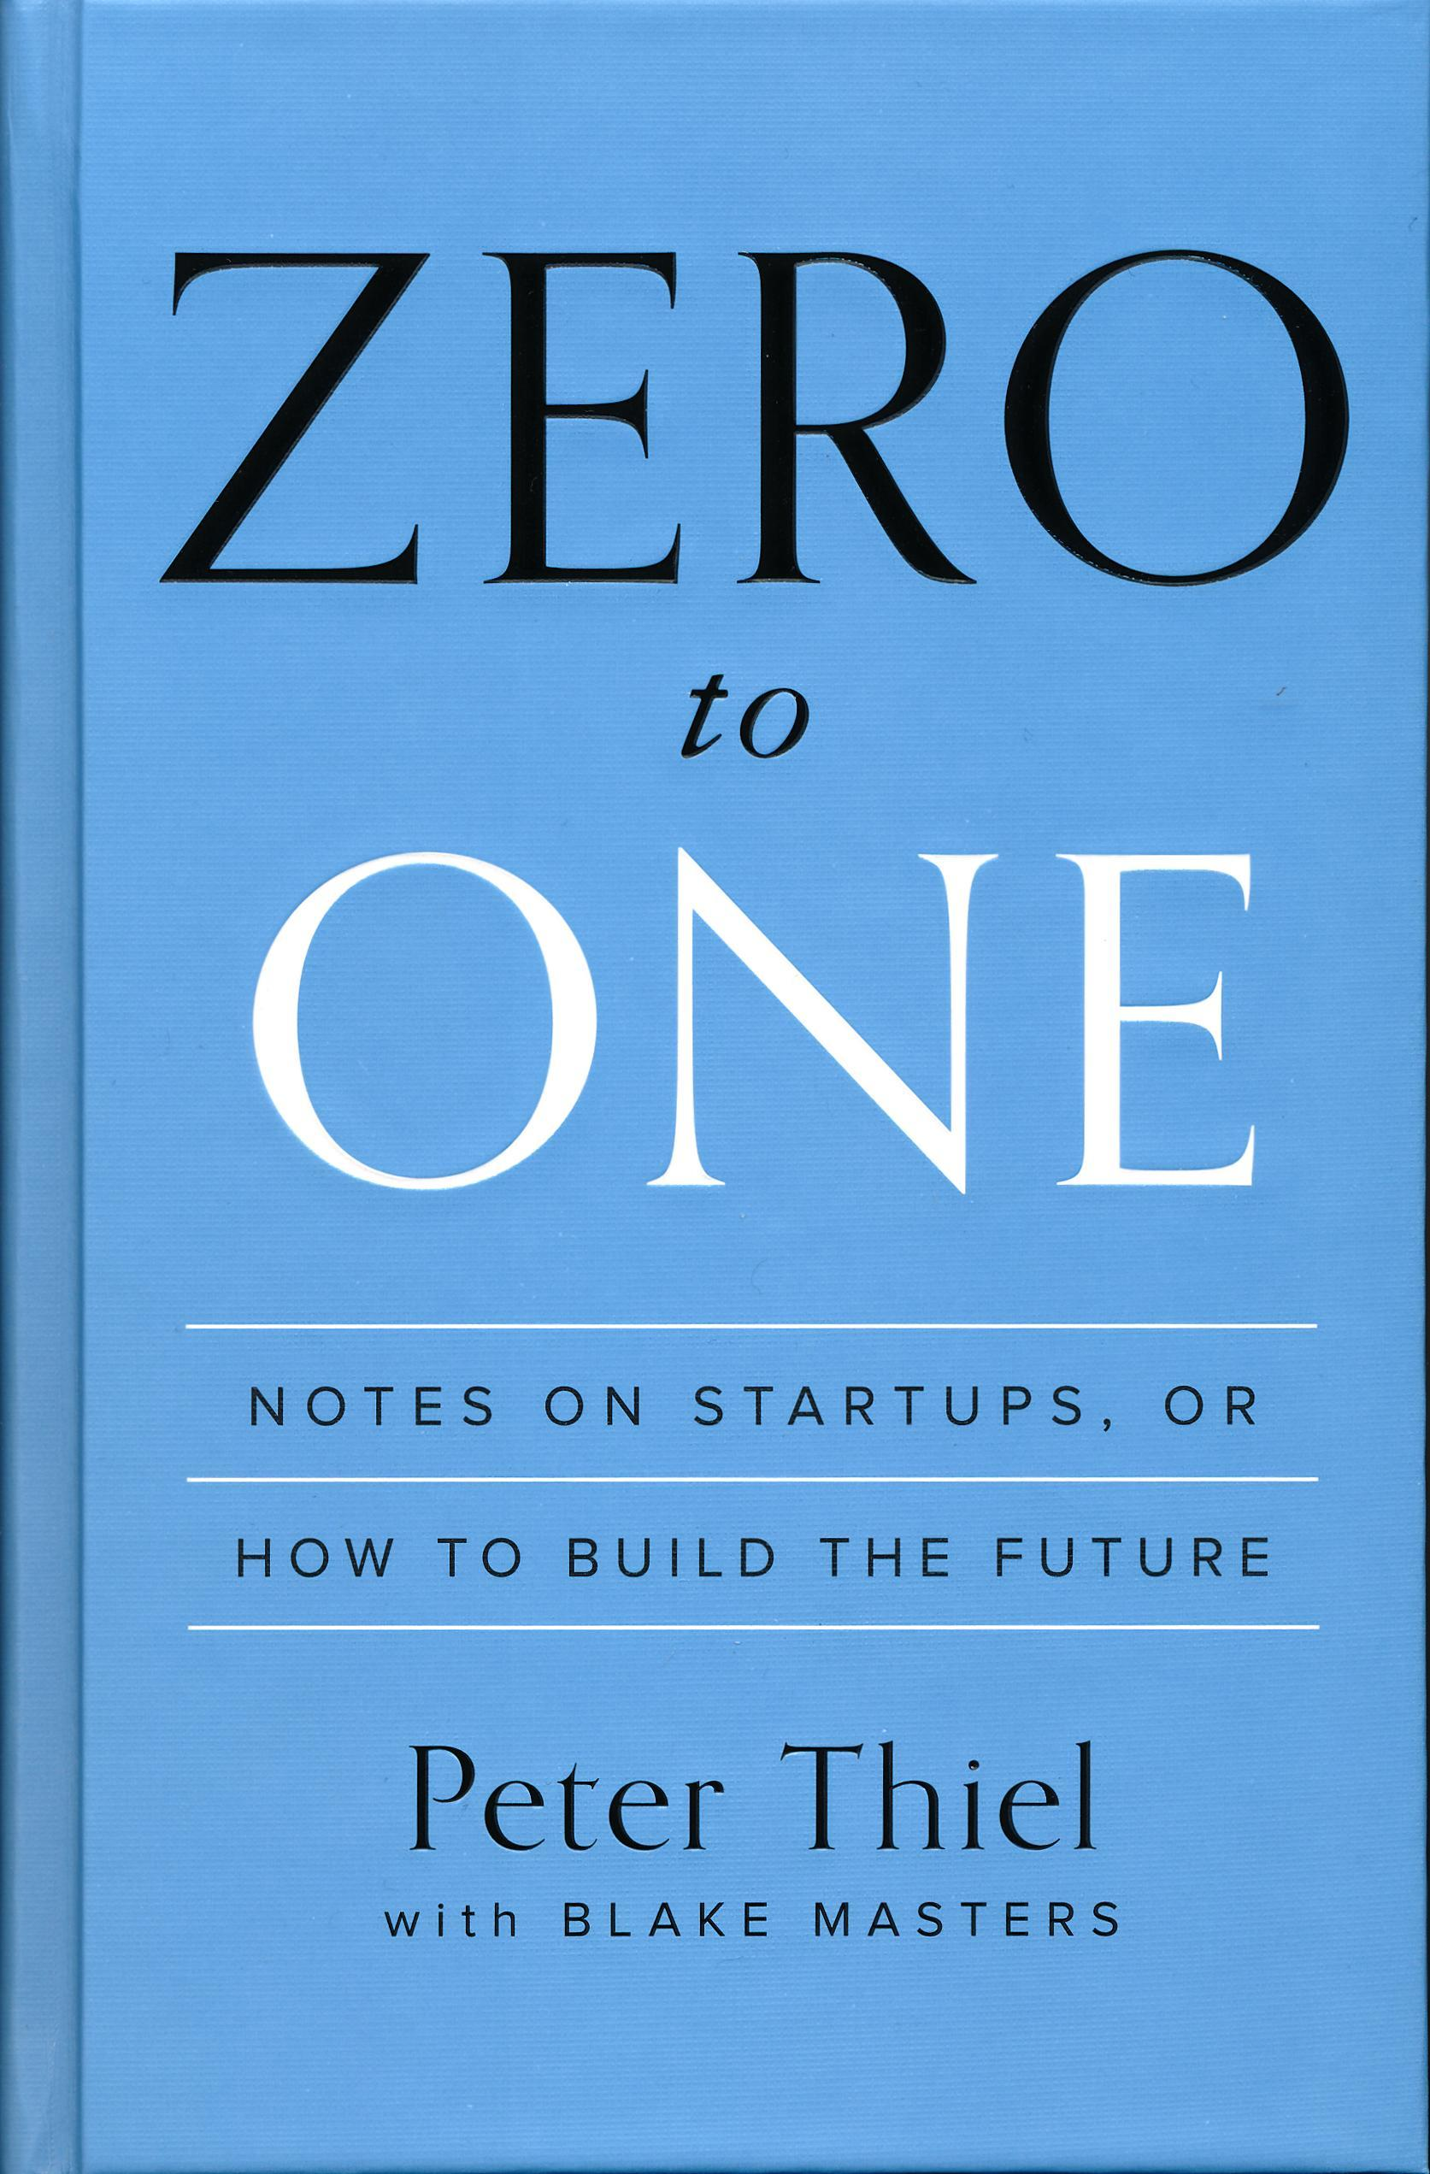
Competition is for losers – Peter Thiel
An unregulated market with a low entry barrier.
Volatile market
Difficult to profit
Limited economies of scale
However, DLB deserves its place in cities.
Genuinely positive societal impact
Cities are not business
Notes:
The rise and fall of the DLB industry shows the risk of an unregulated market with a low entry barrier. The market is unstable, and operators struggle to make profit. Not to mention the market itself has limited economies of scale.
As Peter Thiel, the cofounder of PayPal claimed in his book: competition is for losers in such a market, and good entrepreneurs should simply stay away from it. However, we all know that bikesharing has great positive social impact and it deserves its place in many of our cities. In addition, cities are not just business because we still care about social good.

Slide 24
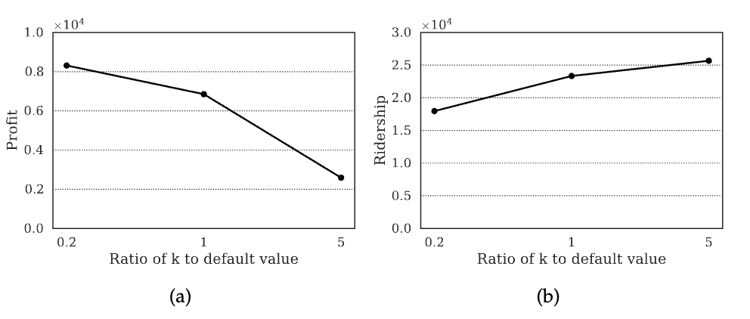
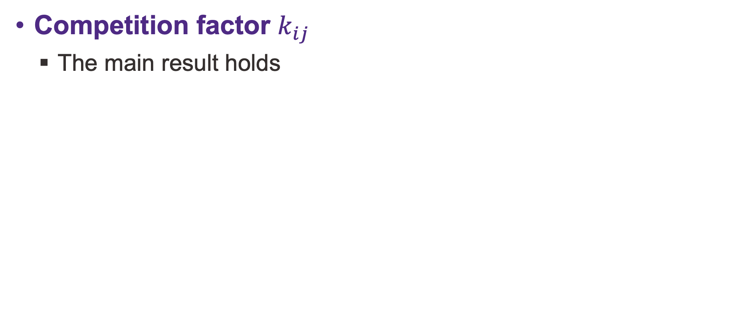
Sensitivity analysis
Competition factor $k_{ij}$
The main result holds
Sensitivity of the system performance to k in a duopoly where both operators maximize profit (a) or ridership without a deficit (b).

Slide 25
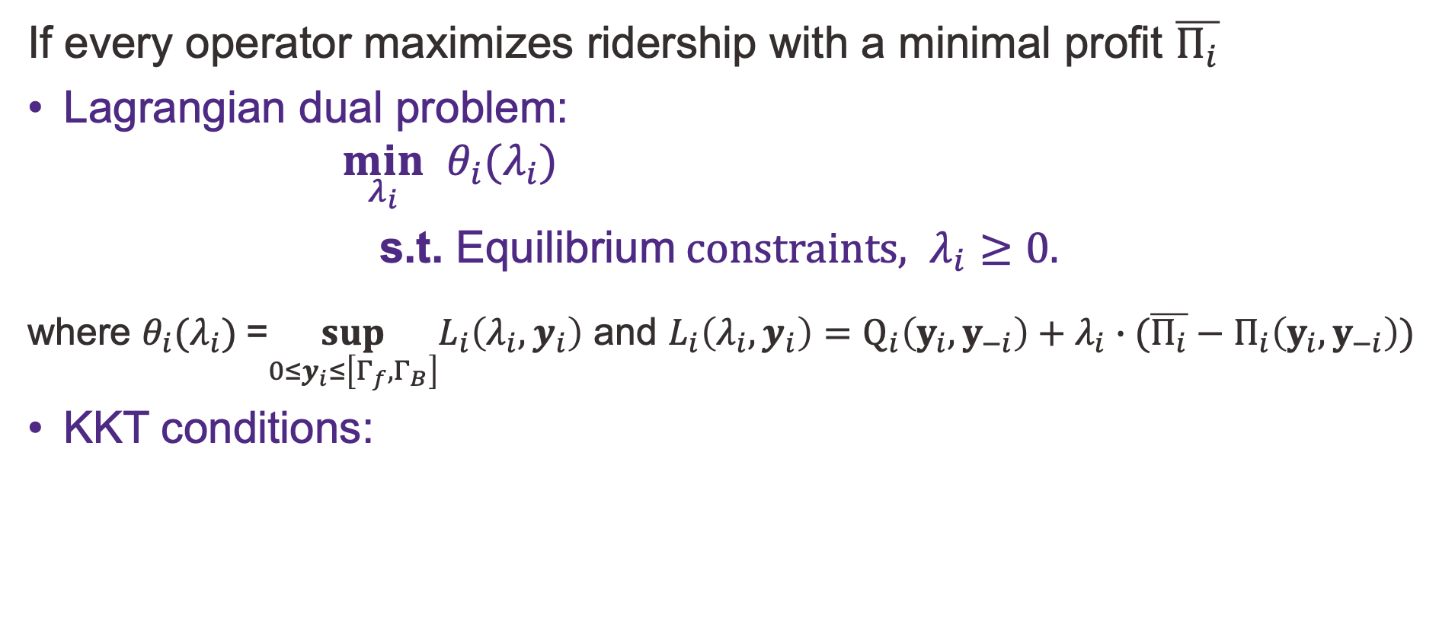
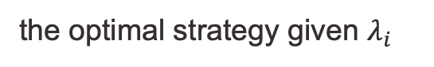
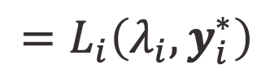
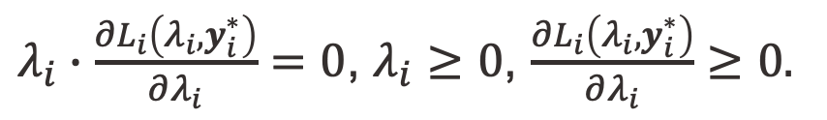
Solution algorithm for the GNE
If every operator maximizes ridership with a minimal profit $\overline{Π_{i}}$
Lagrangian dual problem:
$$\min_{λ_{i}} θ_{i}(λ_{i})$$
$\text{s}\text{.}\text{t}\text{.} \text{E}\text{quilibrium} constraints, λ_{i}≥0.$
where $θ_{i}(λ_{i})$=$\sup_{{0≤y}_{i}≤\left[Γ_{f},Γ_{B}\right]}L_{i}\left(λ_{i},y_{i}\right)$ and $L_{i}\left(λ_{i},y_{i}\right)=Q_{i}\left(y_{i},y_{−i}\right)+λ_{i}∙(\overline{Π_{i}}−Π_{i}\left(y_{i},y_{−i}\right))$
KKT conditions:
the optimal strategy given $λ_{i}$
$$=L_{i}\left(λ_{i},y_{i}^{∗}\right)$$
$λ_{i}∙\frac{∂L_{i}\left(λ_{i},y_{i}^{∗}\right)}{∂λ_{i}}=0$, $λ_{i}≥0$, $\frac{∂L_{i}\left(λ_{i},y_{i}^{∗}\right)}{∂λ_{i}}≥0.$
solved using a Bi-level Dual Gradient Descent (BDGD) algorithm based on auto differentiation.
Notes:
here I just skip all the details

Slide 26
Monopoly: extra numerical results

Slide 27
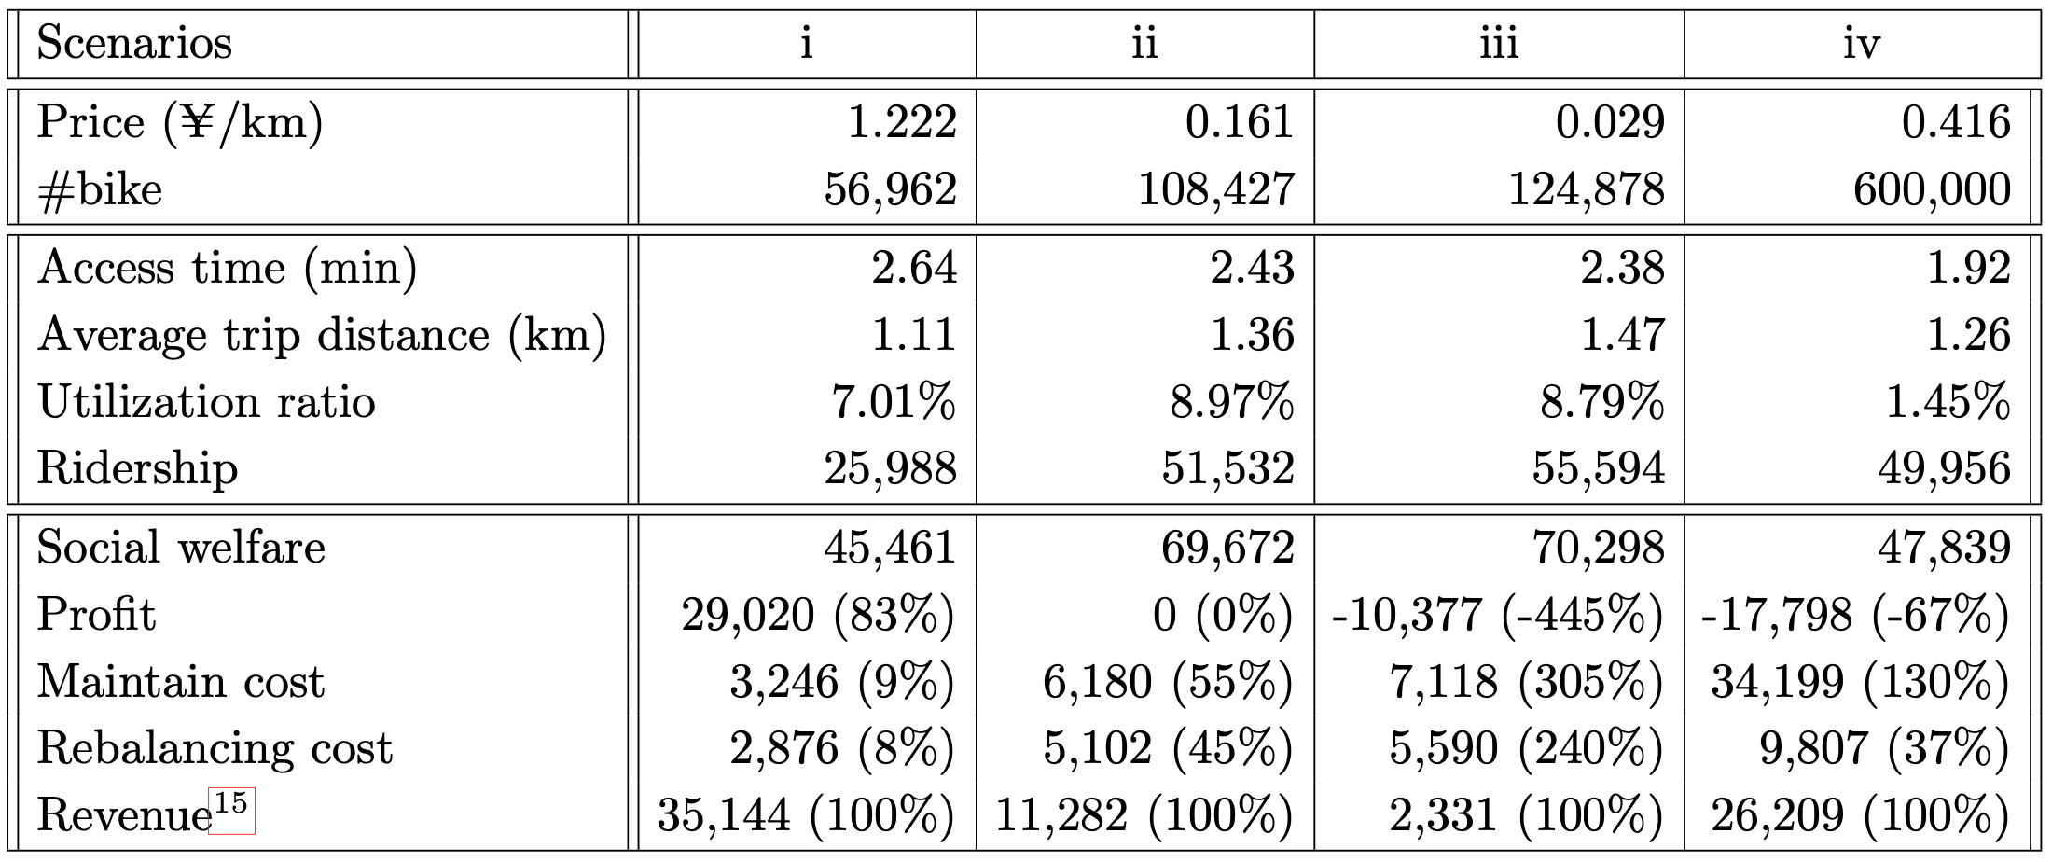
DLB system performances
Profit maximization;
Ridership maximization with non-negative profit;
Social optimum;
The status quo.
Status quo has way too many bikes!
Access time is not that sensitive to fleet size
(ii) is close to social optimum but requires no subsidy.
Notes:
***The fleet size is less than a quarter of the current fleet size.

Slide 28
Sensitivity analysis
ε=100m
Max cluster size 200mX200m
Cluster parameters
Numerical results |  | Various settings
 |  | Default | ε=80m | ε=120m | Max cluster size 150mX150m | Max cluster size 250mX250m
Most balanced scenario | Scenario id | ii | ii | ii | ii | ii
 | Reduced fleet size | 80% | 81% | 78% | 77% | 82%
Profit-maximizing operator | Ridership ratio | 1.58 | 1.61 | 1.57 | 1.60 | 1.59
 | Social welfare ratio | 1.26 | 1.28 | 1.26 | 1.28 | 1.25
Ridership-maximizing operator | Ridership ratio | 1.00 | 1.00 | 1.00 | 1.00 | 1.00
 | Social welfare ratio | 0.66 | 0.65 | 0.67 | 0.71 | 0.60
Ridership/Social welfare ratios are the ratio between the best ridership/social welfare achieved under price control and that achieved under fleet control.
If the ratio is bigger than 1, price control outperforms than fleet control, otherwise fleet control outperforms price than control.
Notes:
Reduced fleet size compared with the status quo.

Slide 29
Oligopoly: solving the GNE

Slide 30
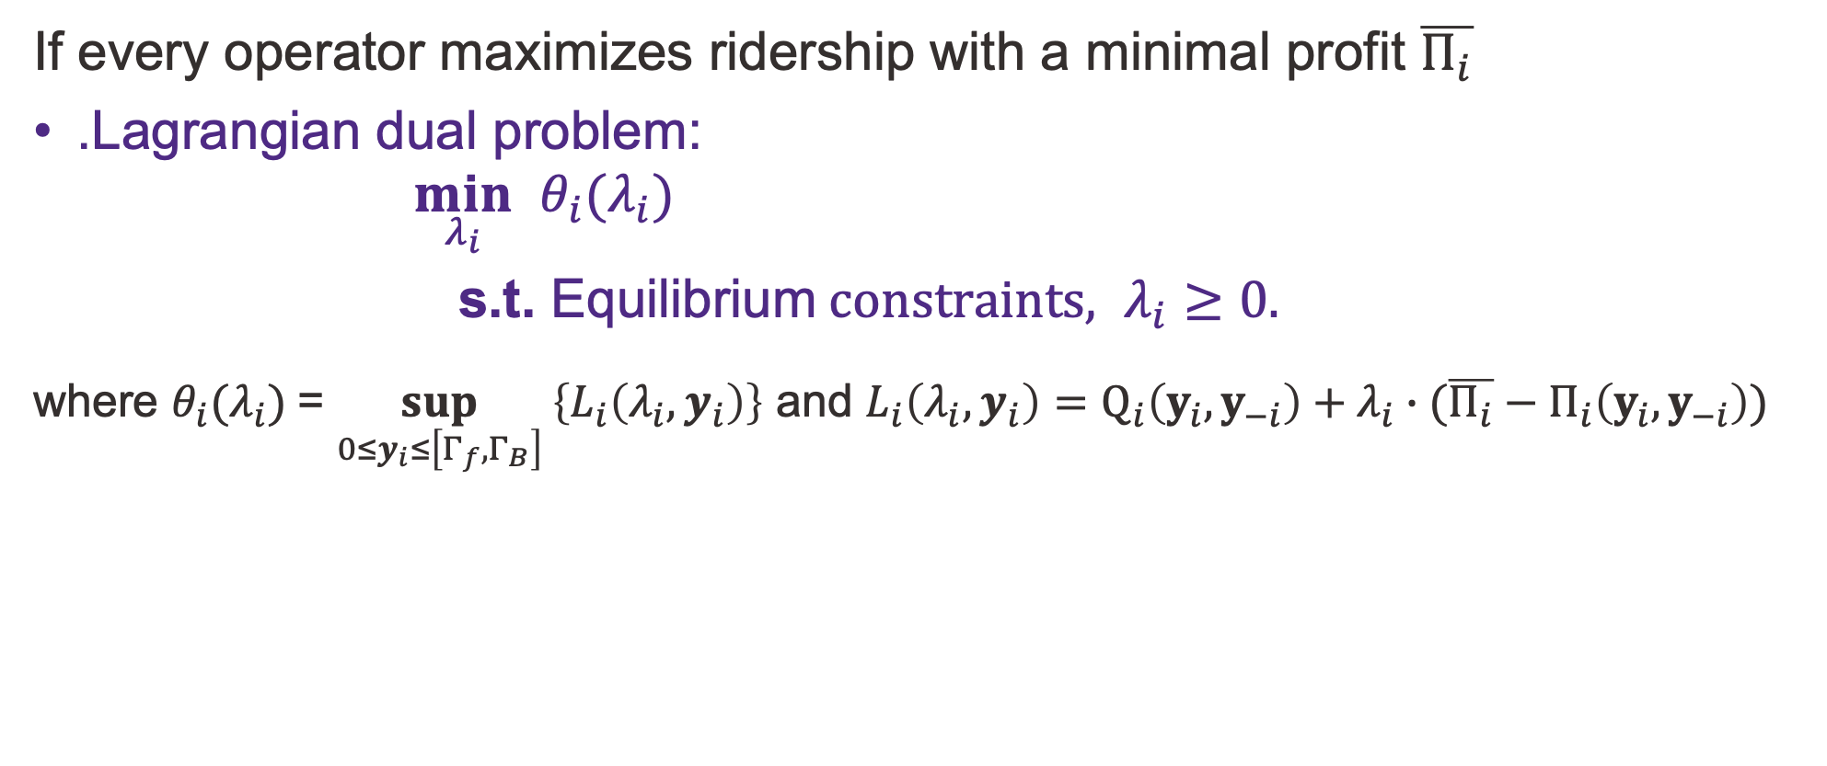
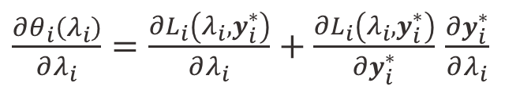
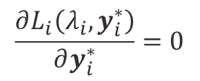
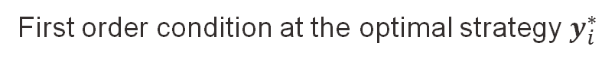

Solution algorithm for the GNE
If every operator maximizes ridership with a minimal profit $\overline{Π_{i}}$
.Lagrangian dual problem:
$$\min_{λ_{i}} θ_{i}(λ_{i})$$
$\text{s}\text{.}\text{t}\text{.} \text{E}\text{quilibrium} constraints, λ_{i}≥0.$
where $θ_{i}(λ_{i})$= $\sup_{{0≤y}_{i}≤\left[Γ_{f},Γ_{B}\right]} \left\{L_{i}\left(λ_{i},y_{i}\right)\right\}$ and $L_{i}\left(λ_{i},y_{i}\right)=Q_{i}\left(y_{i},y_{−i}\right)+λ_{i}∙(\overline{Π_{i}}−Π_{i}\left(y_{i},y_{−i}\right))$
$$=L_{i}\left(λ_{i},y_{i}^{∗}\right)$$
$\frac{∂θ_{i}\left(λ_{i}\right)}{∂λ_{i}}=\frac{∂L_{i}\left(λ_{i},y_{i}^{∗}\right)}{∂λ_{i}}+\frac{∂L_{i}\left(λ_{i},y_{i}^{∗}\right)}{∂y_{i}^{∗}}$ $\frac{∂y_{i}^{∗}}{∂λ_{i}}$
First order condition at the optimal strategy $y_{i}^{∗}$
$$\frac{∂L_{i}\left(λ_{i},y_{i}^{∗}\right)}{∂y_{i}^{∗}}=0$$

Slide 31
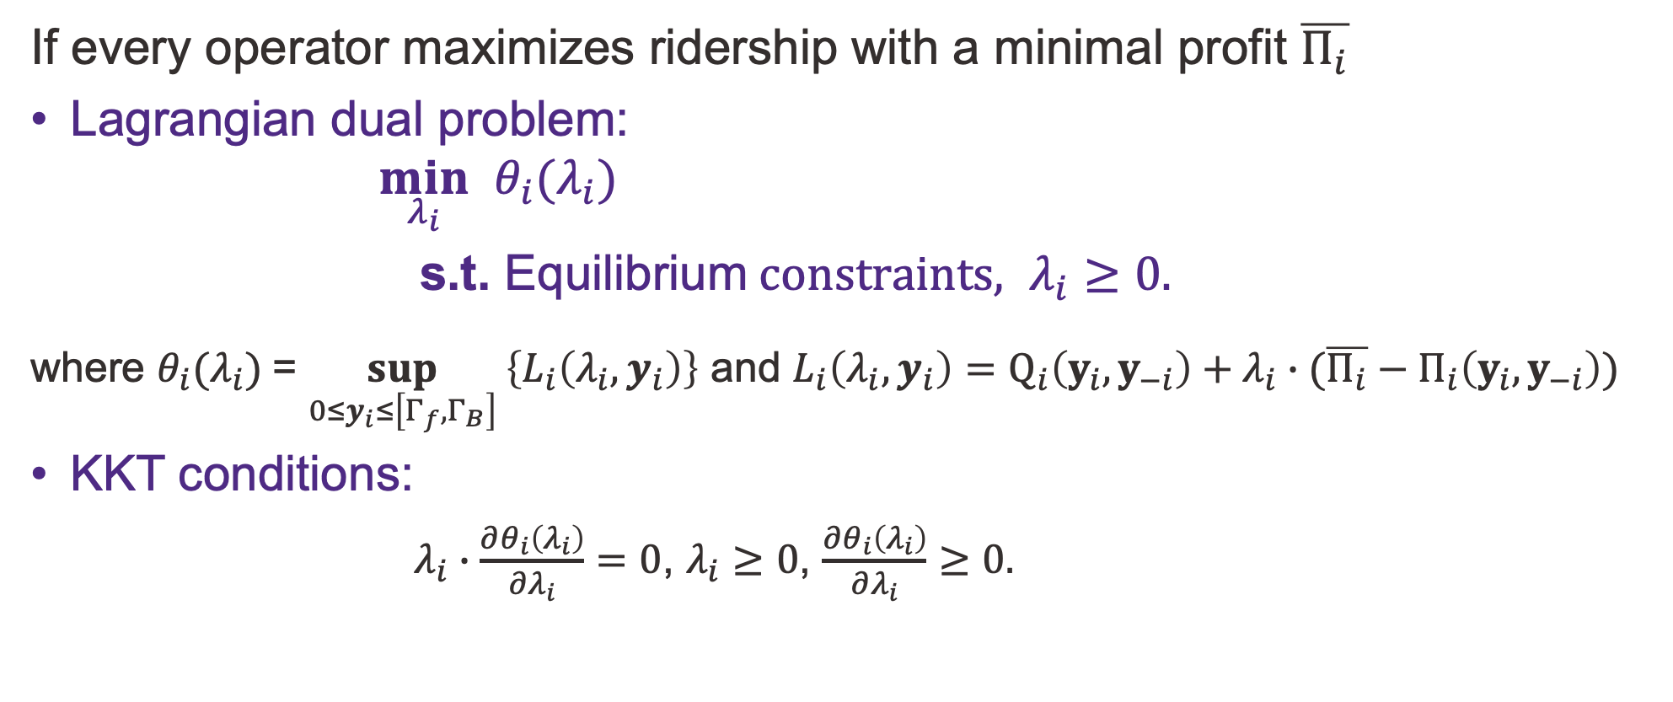
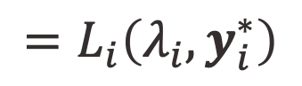
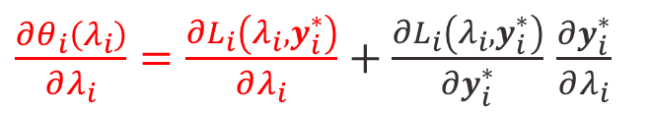
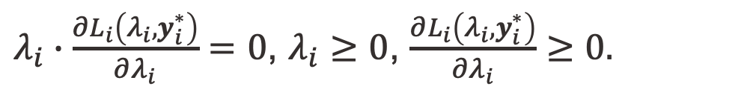
Solution algorithm for the GNE
If every operator maximizes ridership with a minimal profit $\overline{Π_{i}}$
Lagrangian dual problem:
$$\min_{λ_{i}} θ_{i}(λ_{i})$$
$\text{s}\text{.}\text{t}\text{.} \text{E}\text{quilibrium} constraints, λ_{i}≥0.$
where $θ_{i}(λ_{i})$= $\sup_{{0≤y}_{i}≤\left[Γ_{f},Γ_{B}\right]} \left\{L_{i}\left(λ_{i},y_{i}\right)\right\}$ and $L_{i}\left(λ_{i},y_{i}\right)=Q_{i}\left(y_{i},y_{−i}\right)+λ_{i}∙(\overline{Π_{i}}−Π_{i}\left(y_{i},y_{−i}\right))$
KKT conditions:
$λ_{i}∙\frac{∂θ_{i}\left(λ_{i}\right)}{∂λ_{i}}=0$, $λ_{i}≥0$, $\frac{∂θ_{i}\left(λ_{i}\right)}{∂λ_{i}}≥0.$
$$=L_{i}\left(λ_{i},y_{i}^{∗}\right)$$
$\frac{∂θ_{i}\left(λ_{i}\right)}{∂λ_{i}}=\frac{∂L_{i}\left(λ_{i},y_{i}^{∗}\right)}{∂λ_{i}}+\frac{∂L_{i}\left(λ_{i},y_{i}^{∗}\right)}{∂y_{i}^{∗}}$ $\frac{∂y_{i}^{∗}}{∂λ_{i}}$
$λ_{i}∙\frac{∂L_{i}\left(λ_{i},y_{i}^{∗}\right)}{∂λ_{i}}=0$, $λ_{i}≥0$, $\frac{∂L_{i}\left(λ_{i},y_{i}^{∗}\right)}{∂λ_{i}}≥0.$

Slide 32


Solution algorithm for the GNE
Outer loop: update $λ$ until it converges
Inner loop: optimal decision with certain Lagrange multiplier vector

Slide 33
Oligopoly: extra numerical results

Slide 34


Performance: nonstrategic duopoly
Duopoly market
Without deficit
Monopoly market
Lower average rebalancing cost if serving a higher market share
0.175 V.S. 0.167 (¥/VKT)
Less aggressive tactics:
market inefficiency and less profit
Most balanced strategy, further inefficiency
Notes:
delete this page
focus on my strategic competition
Now we are ready for some results. Let’s first look at the
Operators' decisions are closer to the status quo compared to the monopoly one.
A operator would benefit with a decreased average rebalancing cost by serving a higher market share.
For profit-maximizing operators, competition leads to market inefficiencies (low utilization ratio) and less profit produced from the market.
Confirm that maximizing ridership without running a deficit is the most balanced strategy for social good, even in a DLB market with peer competitions.

Slide 35

Regulations
Fleet cap
Total ridership and social welfare achieved by different fleet cap policies. (a) Both operators maximize profit. (b) Both operators maximize ridership

Slide 36

Regulations
Fare cap
Total ridership and social welfare achieved by different fare cap policies. (a) Both operators maximize profit. (b) Both operators maximize ridership
profit maximization is still dominated by ridership maximization.

Slide 37

Why should the U.S. care about micromobility?
If used correctly
Low travel cost
Improve efficiency
Promote decarbonization
More e-bikes than electric cars
Over ½ trips are under 3 miles
Source: US Bureau of Transportation Statistics
Source: Kelley Blue Book
Notes:
But what does any of these have to do with the US? And why should we care about micromobility?
Well, when used correctly, it can -----. More importantly, it has already been a dominant part of electric fleet in the US. As you can see here, the sales for e-bikes have always been higher than that of electric cars.
What’s even more interesting is that more than half of the total daily trips are actually below 3 miles, which is the perfect length to substitute with micromobility.

Slide 38
Compared to docked bike-sharing (DB)
DLB services | Pros | Cons
For passengers | Flexible bike locations (rent/return); No return failures (bikes can be returned anywhere V.S. no available dock in a DB station); | No expectation where idle bikes could be (no GPS tracker on DLB bikes at the early stage);
For the operator | No need to optimize the allocation of stations and docks (long-term resource allocation); Ability to dynamically adjust idle bike locations; Minimal infrastructure cost; | Extra effort to identify under/over supply of idle bikes; Higher rebalancing needs (rebalancing frequency: 0.2 for DLB and 0.1 for DB); More complex rebalancing problem; High requirements for bike maintenance;
For the regulatory agency | No equity concerns on station distribution; | Oversupplied bikes could block streets;
For modelers | Real destination of demand from trip data. | Difficulty to identify real demand due to rent failure (DB systems can estimate real demand based on the time ratio when no bike/dock is available in each station.) Inability to restore the time of rebalancing trips.
Notes:
Before we formally introduce our research question. Let’s have a closer look at the difference between dockless and docked systems. Here I conduct a pros and cons analysis.
------, passengers benefit from flexible bike locations and there is ------, ------ while having minimal infrastructure cost.
------ therefore, the rebalancing problem is more complex and the requirement of bike maintenance is also higher
SO how do all of these reflect in the eyes of a modeler? ------ since we don‘t know how many people wanted to rent a bike but failed to find one. ----- because we don‘t know when it happens. Knowing all of these modeling challenges, ------

